Slide 1
BeeHappy
-Germany Task Group:
Yunzhou Feng
Kecheng Li
Ziyang Jiang
Jingyu Su
Weining Chen

Slide 2
Background Research
Target audience: college students and young workers
Original problem space: lack of convenient psychological assistance
Problems space after background research: bad mood and pressure in daily lives
Focus of background research: depression and anxiety
Method: 5 Academic Research Paper, 4 Interviews, 3 Questionnaires and 1 Industry Report

Slide 3
Implication on Our Solution
Disadvantages of traditional psychological treatment: cost, time, language, shortage
Disadvantage of online psychological treatment: legality, not face-to-face, trust
Implication about the design: communication methods, simple design, trained professionals, safety, privacy

Slide 4
Main Findings
Main causes for the health challenges of our target audiences: study, work, family, relationship
Impact of surroundings on patients: social contacts, families, friends, listeners
People’s attitude towards psychological assistance: not positive
Services our target audiences may want: one question, assessment, clinics, language, listeners

Slide 5
Combined Research Results
After combining all the research results, we decided to refocus our project on a different direction
At the beginning we started from a very wide problem space - psychological problems
So we narrowed it down into helping university students relaxing and keeping them in a positive mood
Finally we made our target audience a little bit larger.
Notes:
Which is very hard to solve in the our stage because we try to building a online therapy system
We think the target group maybe too small
It become all the young professional who feel slightly depressed, unhappy or negative, and they want to be/keep positive or make a change.

Slide 6
Primary personas
People who feel slightly depressed, unhappy or negative, and want to be/keep positive or make a change.

Slide 7
Solution for our problem space
We have two choices – we can either build a website or build a phone app
After further analysis on the user needs and our capability of programming, we finally decided to develop a mobile phone app
There are already a lot of successful social apps like Facebook, twitter and Instagram
Inspired by those apps, we managed to figure out an approach to the solution of our problem space, which borrows a lot of ideas from those apps, but also with our special ways addressing on the problems space

Slide 8
Design requirements
Less functions
Neat
Clean
Easy to understand and use

Slide 9
What we learned from informal usability test
Method: individual paper prototype
Problems:
Icon
wording
Notes:
In this informal usability test, we used paper drawing to present our APP to users. Each of our group members design APP interface individually. We want to combine best part of our design later on, and pay more attention to the problems that users mentioned in usability test. We believe that this separate-combine process will lead a better outcome.

Slide 10
Problem 1: Icon
User could be misled by inappropriate icons
An icon can mean different to user who use different social media APP

Slide 11
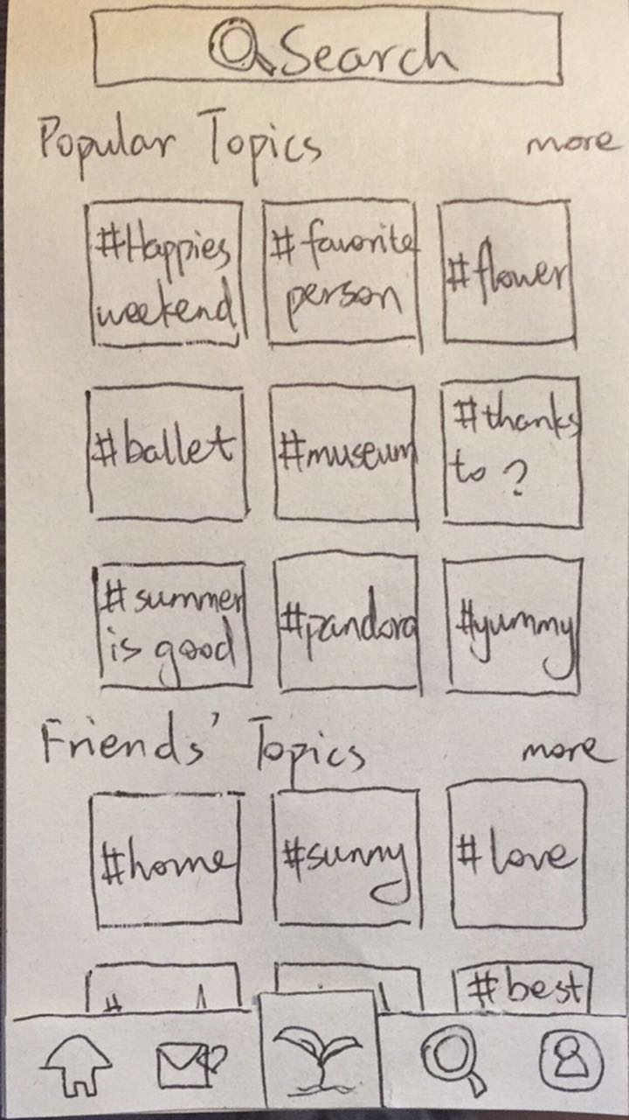
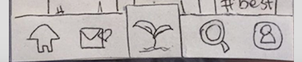
A little tree?
It is a “Write Post” button!!!!

Slide 12
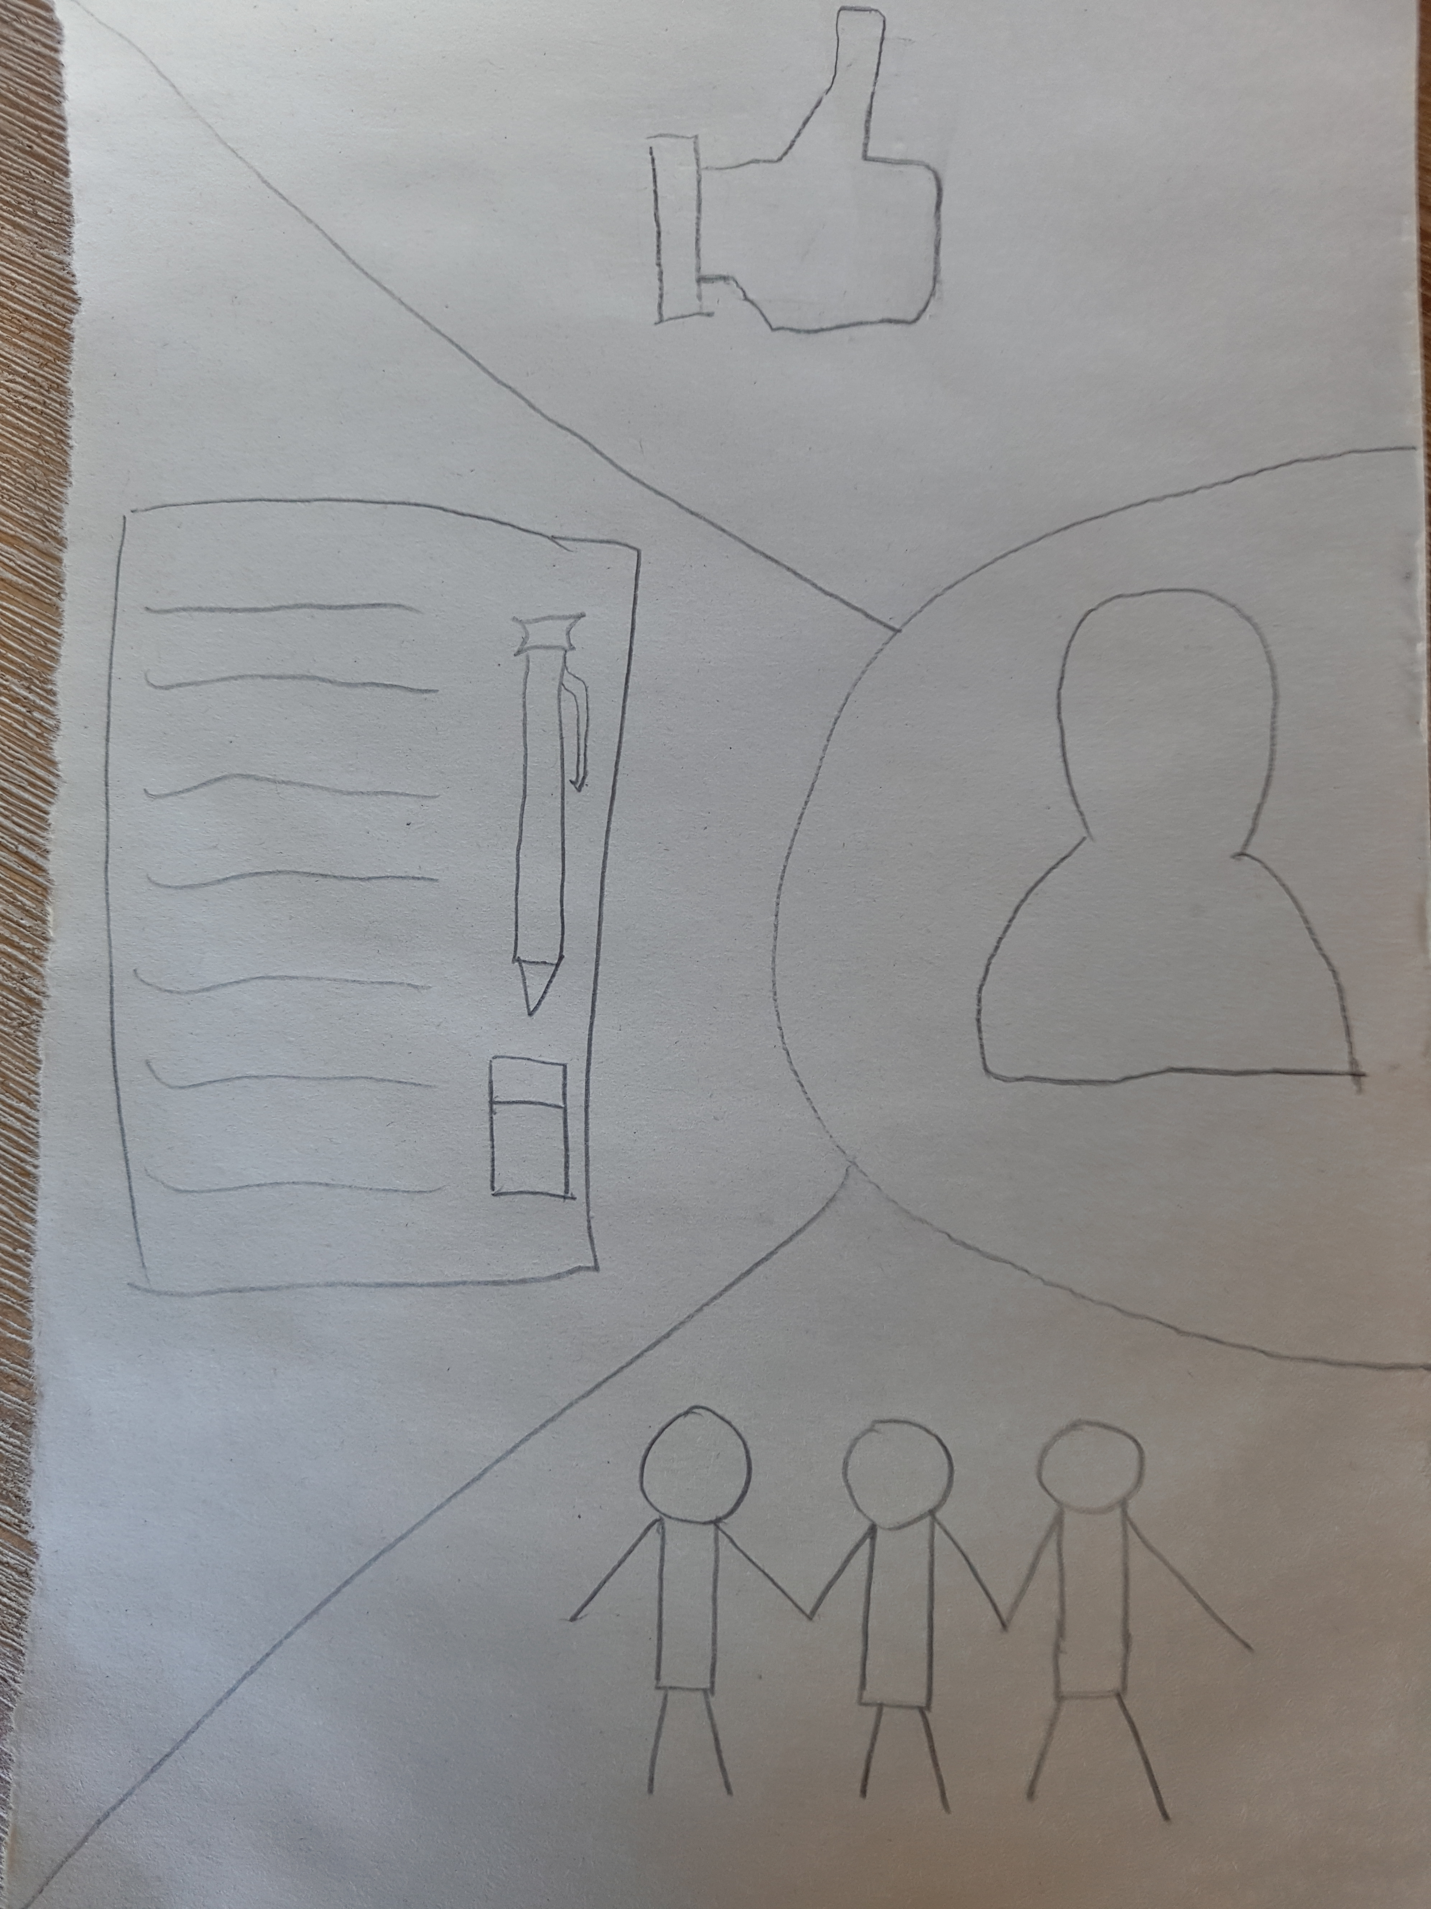
Problem 1: Icon
“Like” button?
What does this icon mean?
Notes:
Like->recommandation post
3 people ->following

Slide 13
Problem 2: wording
If a user have used a similar app, they are easier to understand similar wording and concept in our APP
What makes sense to you does not necessarily make sense to others

Slide 14
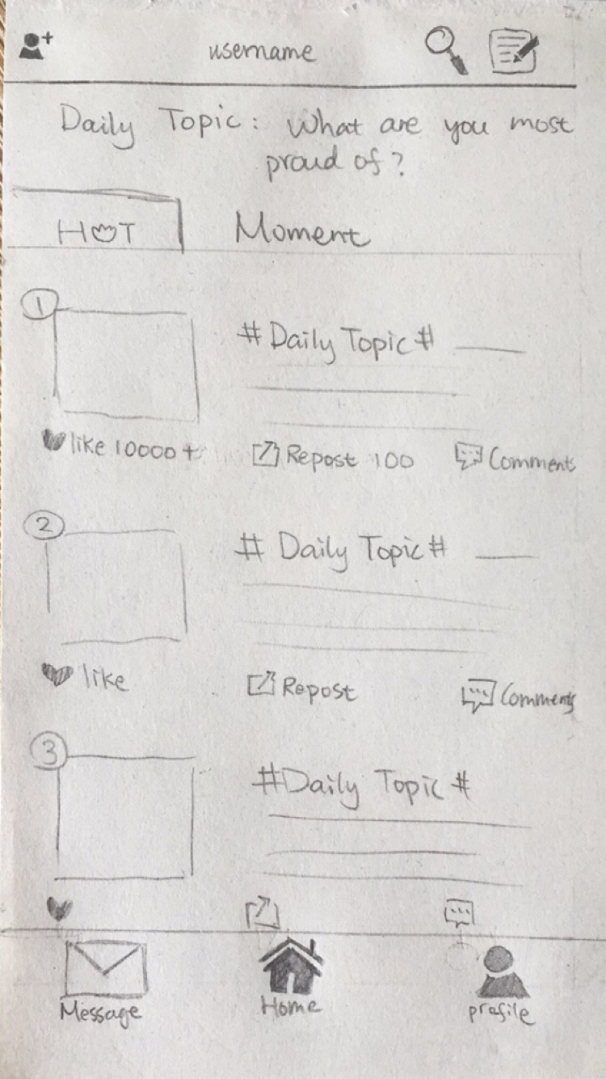
Problem 2: wording
What does “Moment” mean?

Slide 15
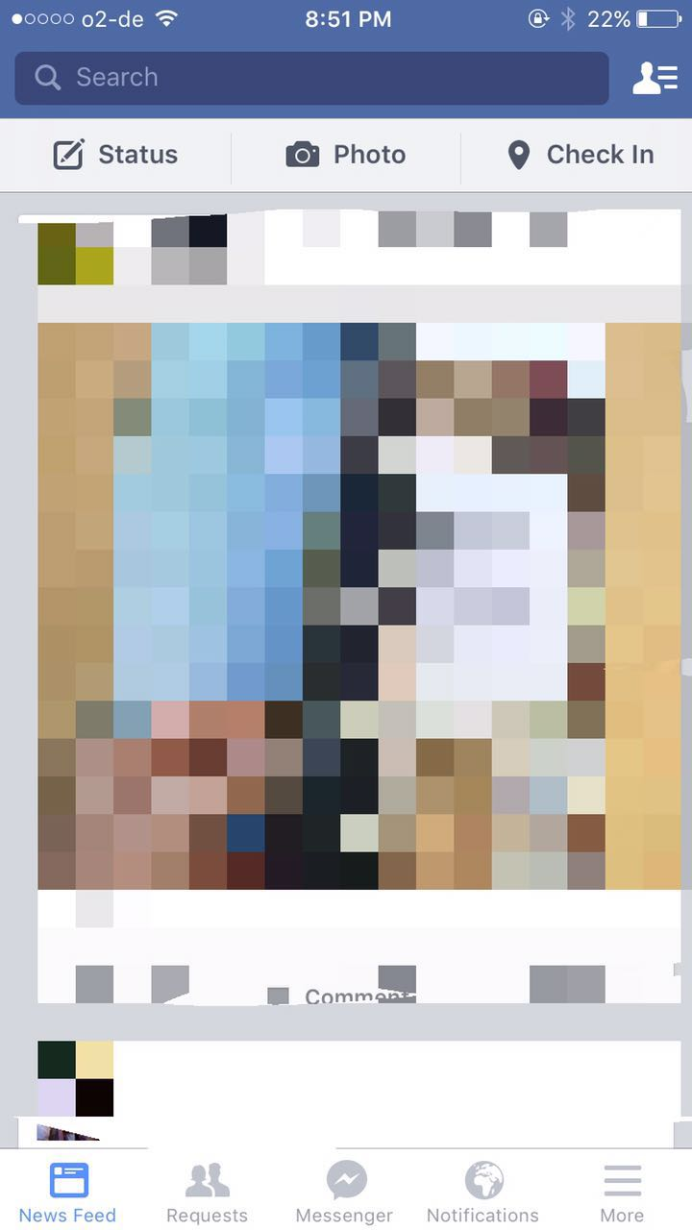
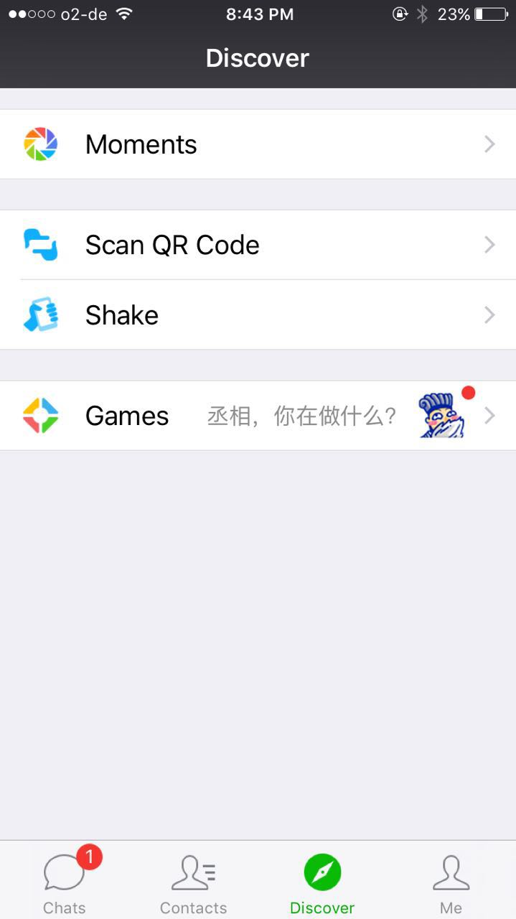
Chinese social media: Wechat
Facebook

Slide 16
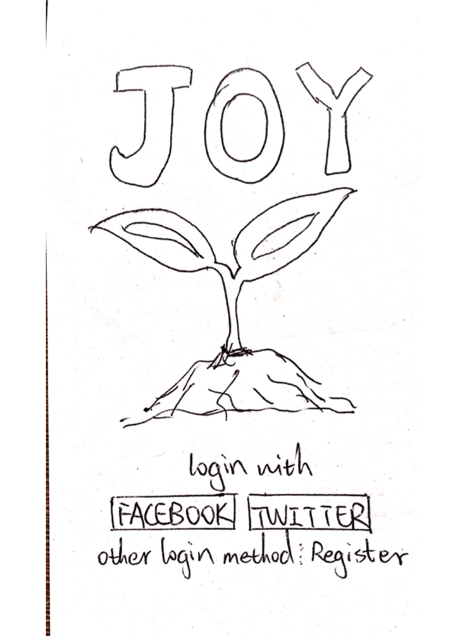
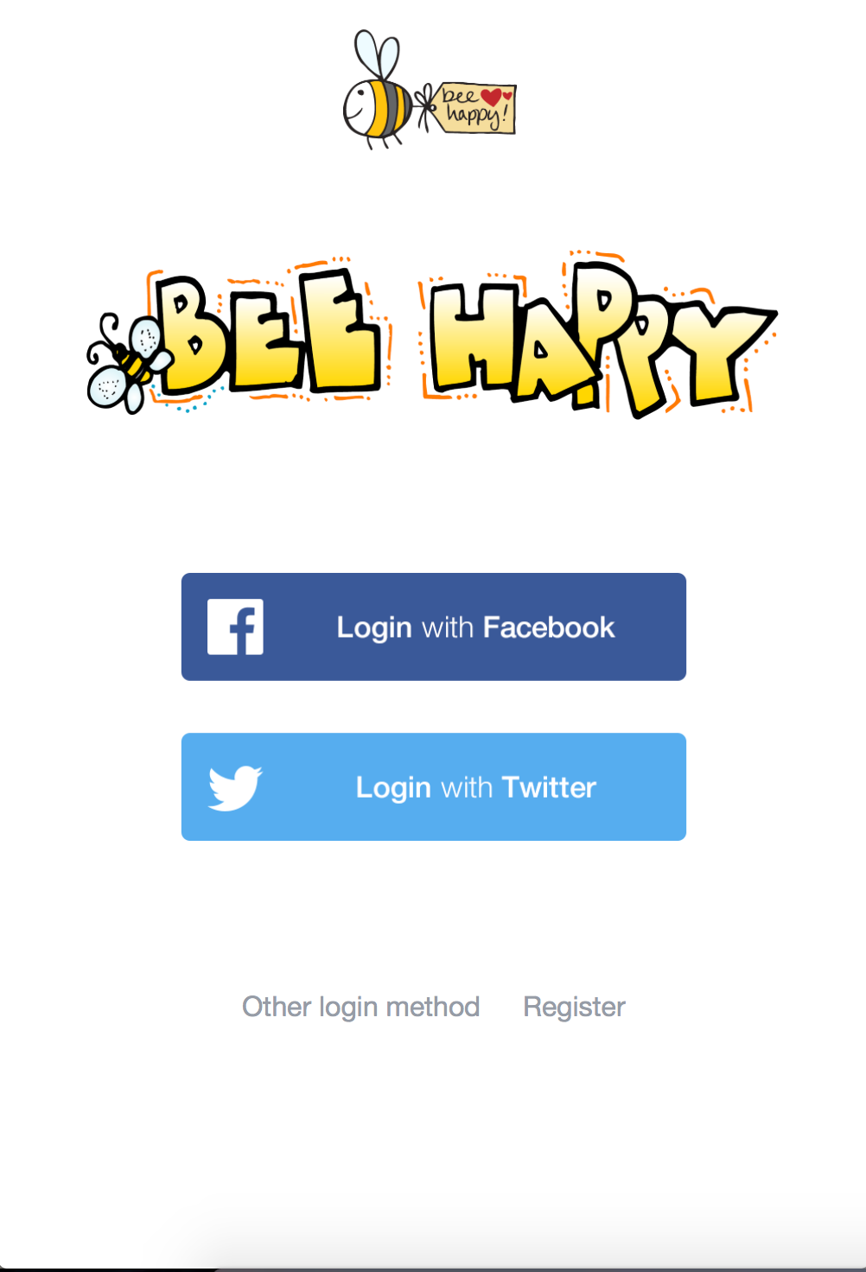

Combine individual works
Use the main structure of one best low-fi prototype
Change the logo and name the prototype as “BeeHappy”
Gathering individual advantages
16

Slide 17
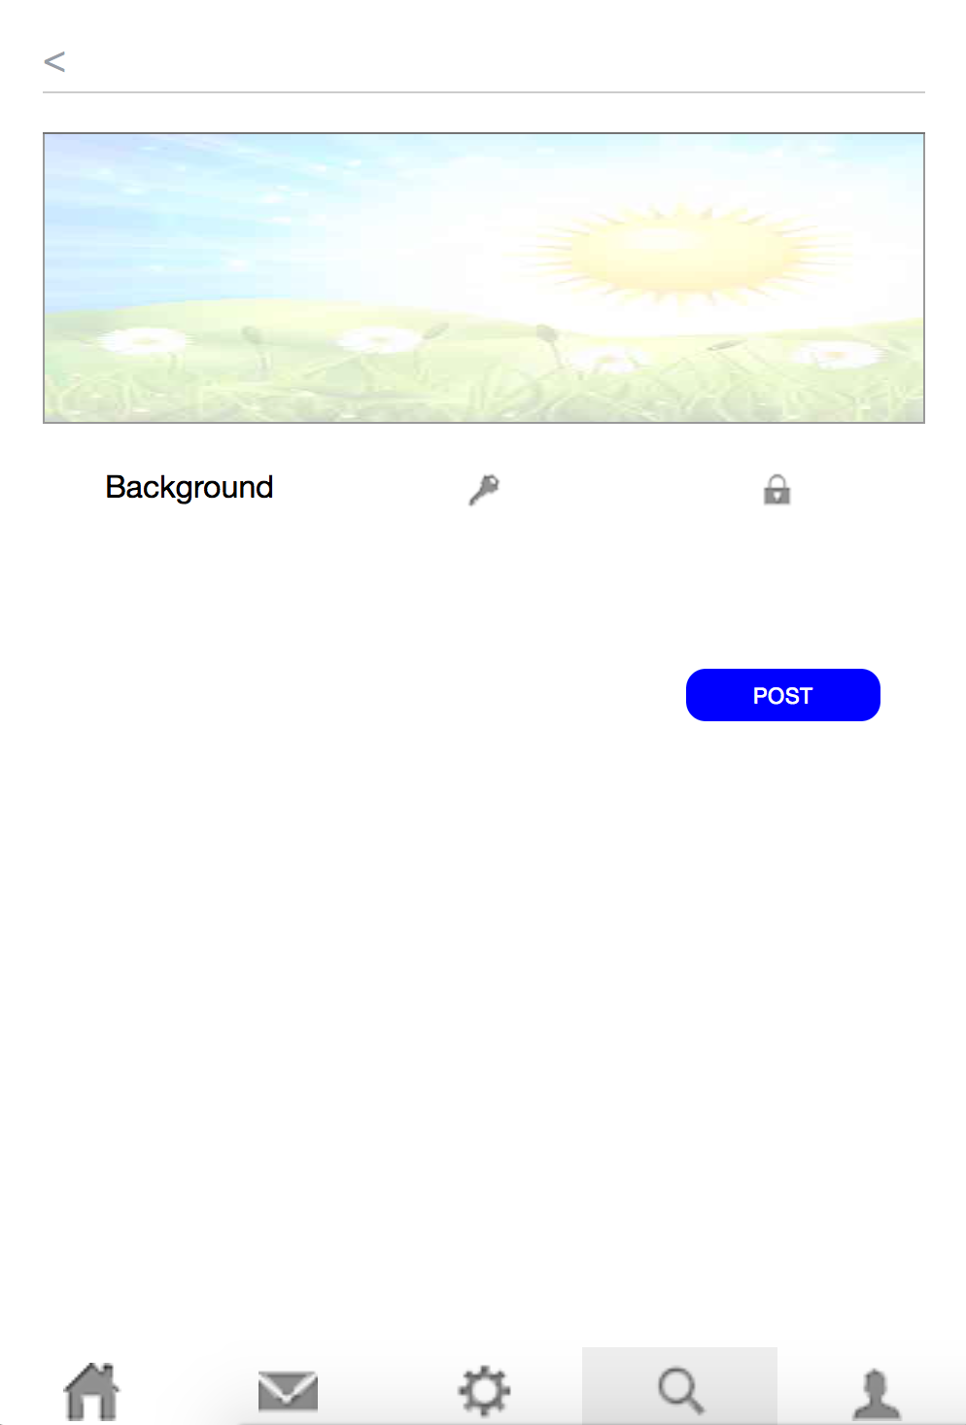

Adding New Feature “Locker” button
Three way to post
To all
To Followers
Save as private
17

Slide 18
Formal usability test plan
1. Prepare a consent form
—Get the permission from participants
2. Make a pre-test Questionnaire
—Make sure the participants are in our target audience
3. Create 2 interaction Sequences
—Create interactive tasks for participants
4. Prepare a test scriptCreate
—Help the facilitator during the test
5. Following up questions
—get more sense of the confusion in participants’ mind
6. Encourage participants Think Aloud
18

Slide 19
Formal Usability Test
6 formal usability tests
2 tasks following test script, interview, questionnaire
Collecting and analyzing feedback from participants
Change the product

Slide 20
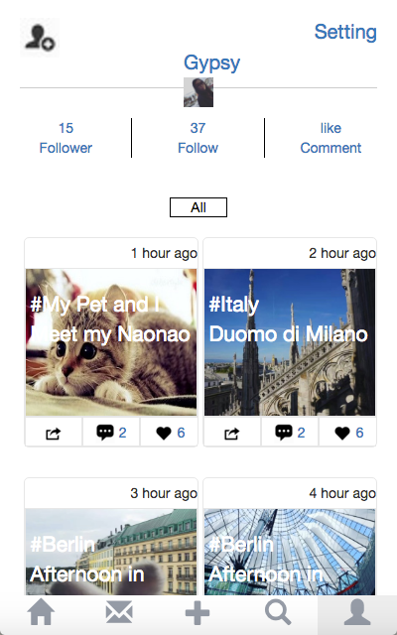
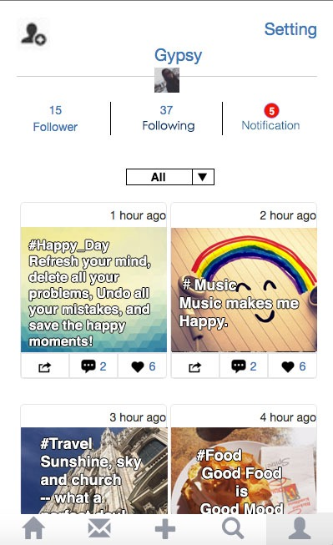
BEFORE AFTER
“Follow” is not clear
“like comment” is not clear
“All” is not obvious
-change “follow”to “following”
-add “notification”
-add arrow to “All”

Slide 21
Final Product

Slide 22
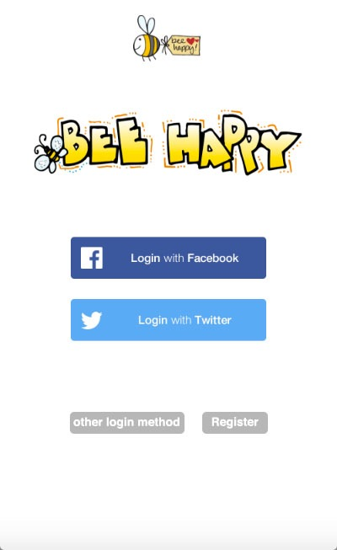
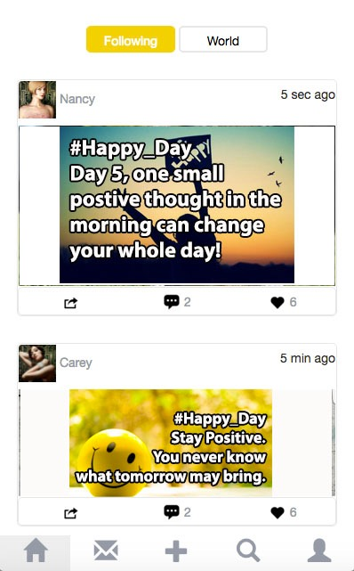
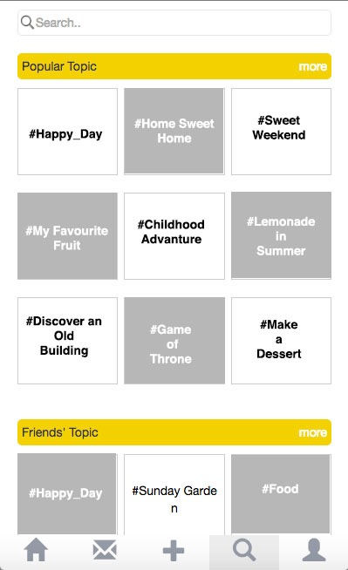
Login Page Home Page Search(Topics) Page

Slide 23
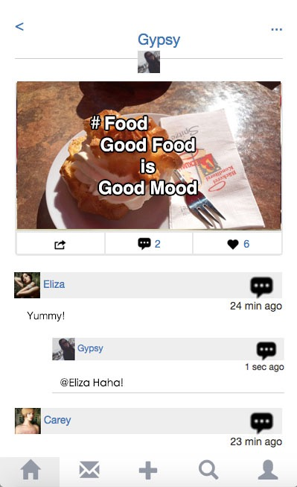
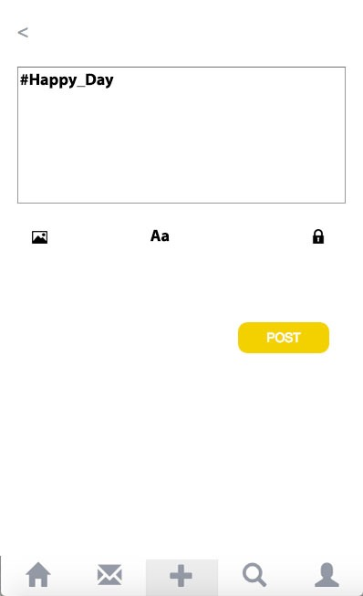
Personal Page Post Detail Post New Post

Slide 24
More to add
Soothing music
Easy post to other popular social media, like Facebook, Twitter, etc
Psychological professionals

